Slide 1
GitHub to Start
SESSION 2
UTM KUALA LUMPUR

Slide 2
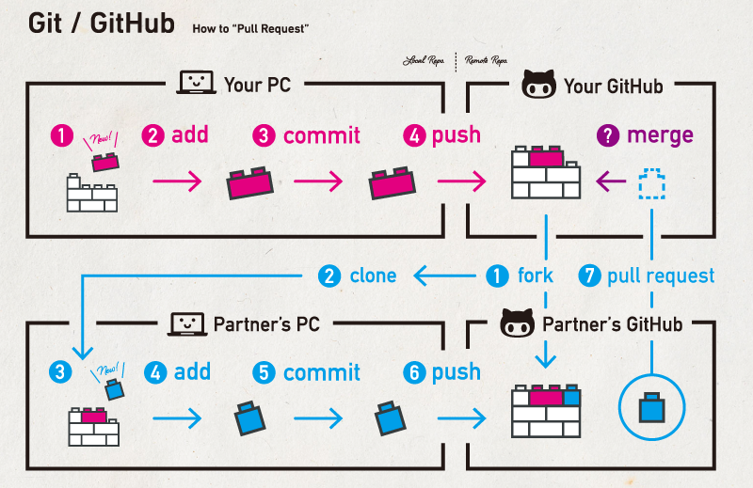
Understanding Fork, Clone and Branch

Slide 3
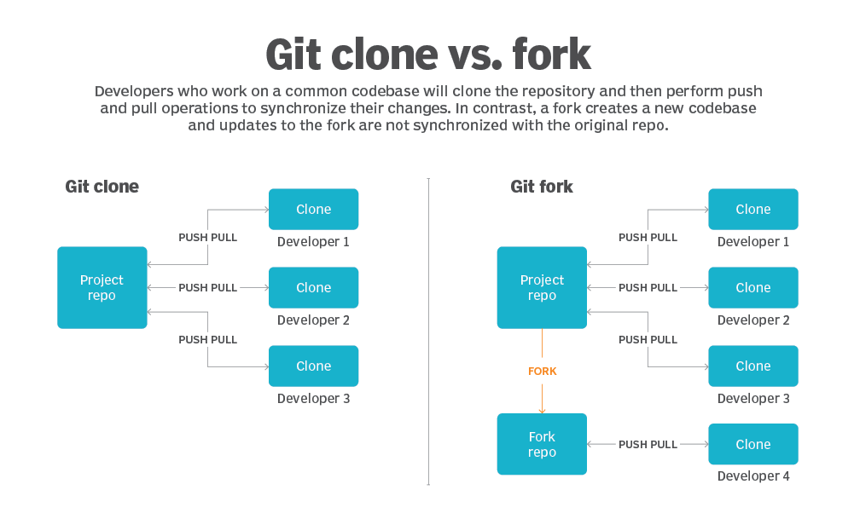

Slide 4
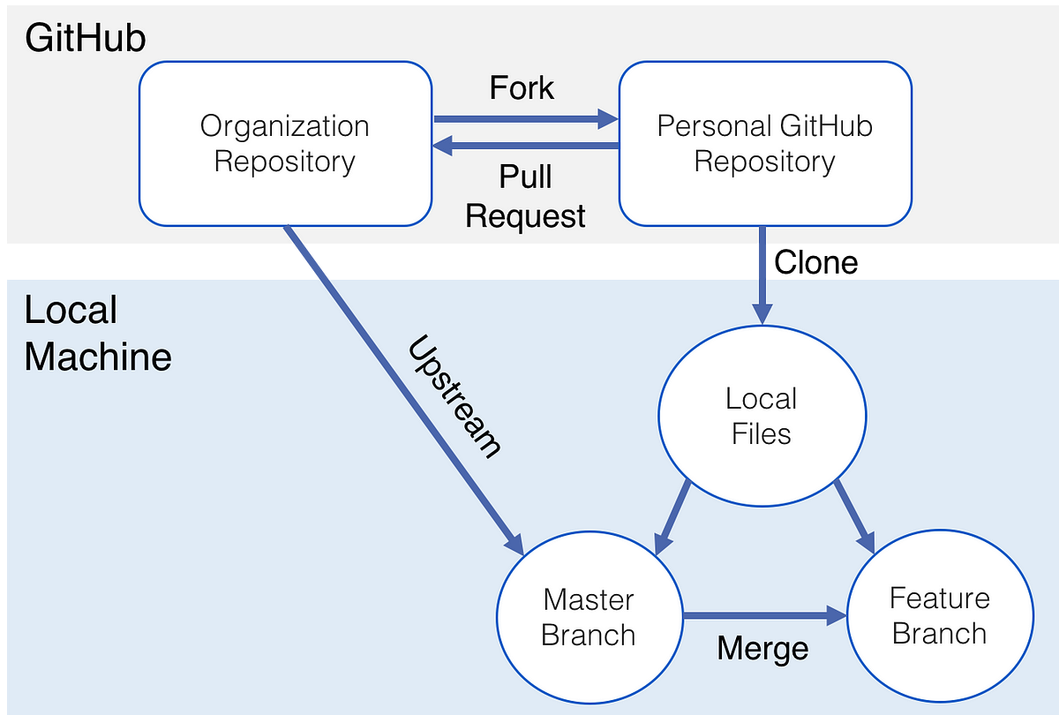

Fork is one-time duplicate repo. Not auto update
Repo can request updates from others by pull request
Your recent work should be in different branch, avoid conflict with main repo updates
To keep your forked repo updated to main repo without pull request

Slide 5
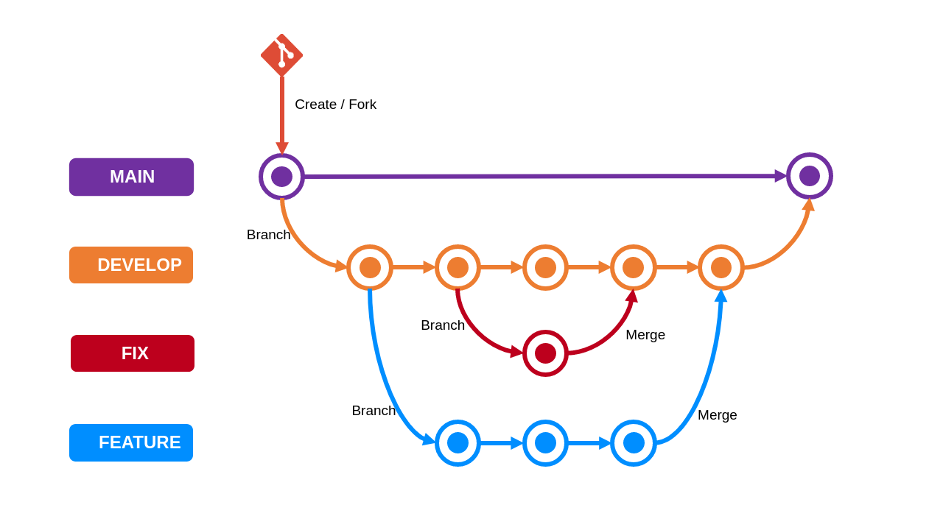
Once fork from other repo, preferable reserve existing branch easier get updates from original repo

Slide 6
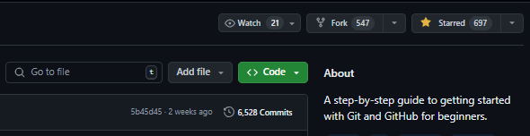
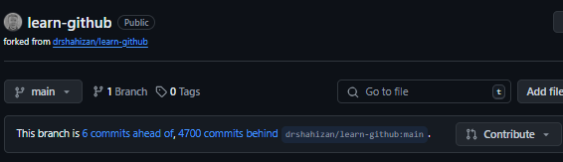
How to fork?
    Forking a repository means creating your own copy of someone else's repository on GitHub. This is commonly done when you want to contribute to an open-source project or work on a project without affecting the original repository.
Steps to Fork a Repository:
Go to the Repository on GitHub:
  Navigate to the GitHub repository you want to fork.
Fork the Repository:
  Click on the Fork button at the top right of the repository page.
  GitHub will create a copy of the repository under your GitHub account.
Forked repo

Slide 7
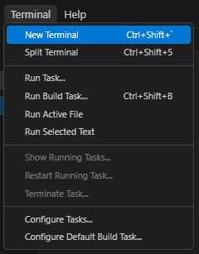
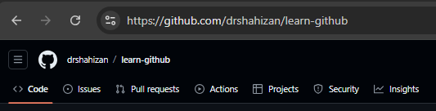

Create Upstream using VSCode
First, make sure you've already forked the repository on GitHub and have it cloned to your local machine.
After cloning your fork, you need to add the original repository (upstream) as a remote to your local Git repository.
Add Upstream in VS Code:
  Open the terminal in VS Code.
  Add the upstream repository using the following command :
  git remote add upstream https://github.com/<original_username>/<original_repository>.git
  Replace <original_username> with the username or organization name of the original repository owner
  Replace <original_repository> with the name of original repository
Verify Upstream in VS Code:
  Can verify by running command :
  git remote -v

Slide 8
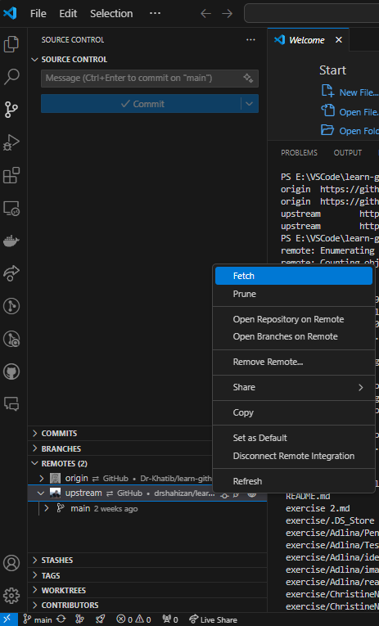
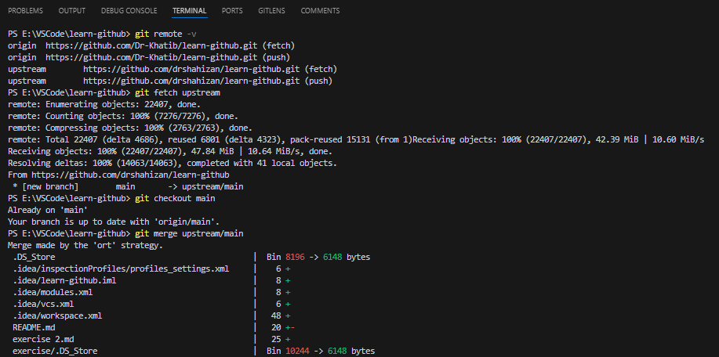
Create Upstream using VSCode
Fetch and merge from Upstream in VS Code:
git fetch upstream
git checkout main
git merge upstream/main
git push origin main
Or Without command :
After fetch will be sync available here and sync it
Can fetch here without command

Slide 9
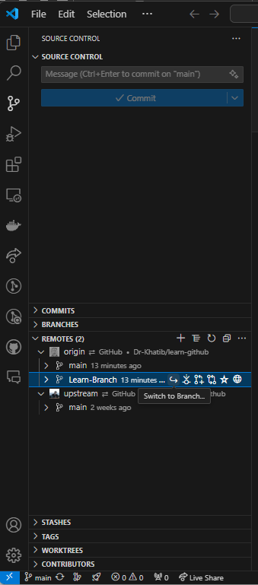
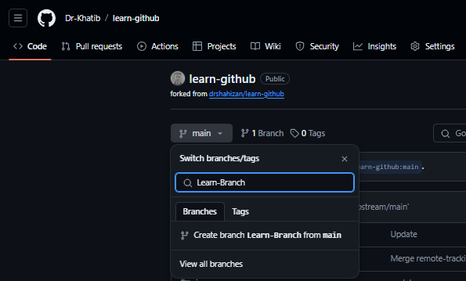
Create Branch from GitHub (Browser)
To make update in branch need to switch to it here or using command
git checkout <repo_name>

Slide 10
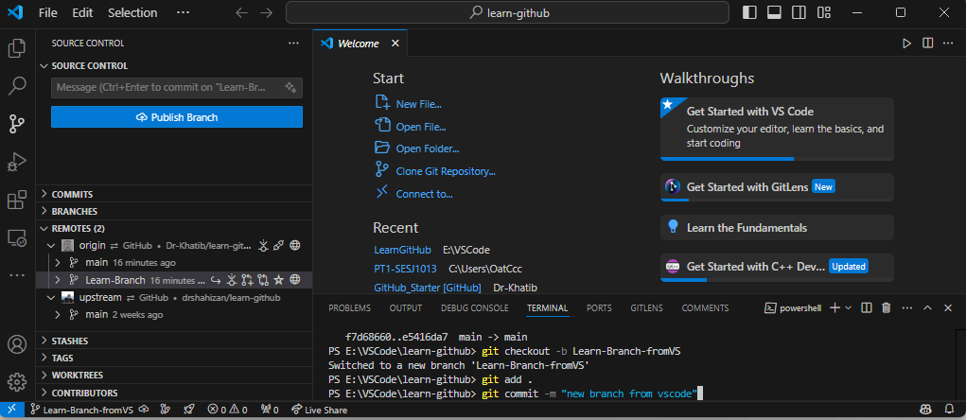
Create Branch from VSCode
Commit branch with message or using button publish branch
Create branch
Commit branch with message or using button publish branch

Slide 11
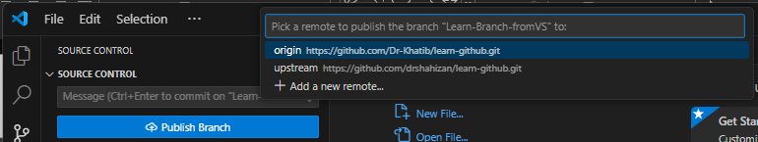
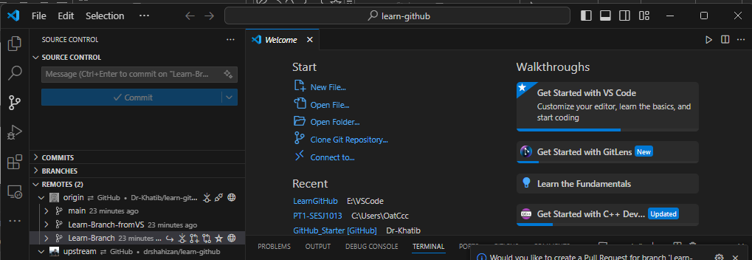
Create Branch from VSCode
2. Commit branch with message using button publish branch
1. Press button publish branch

Slide 12
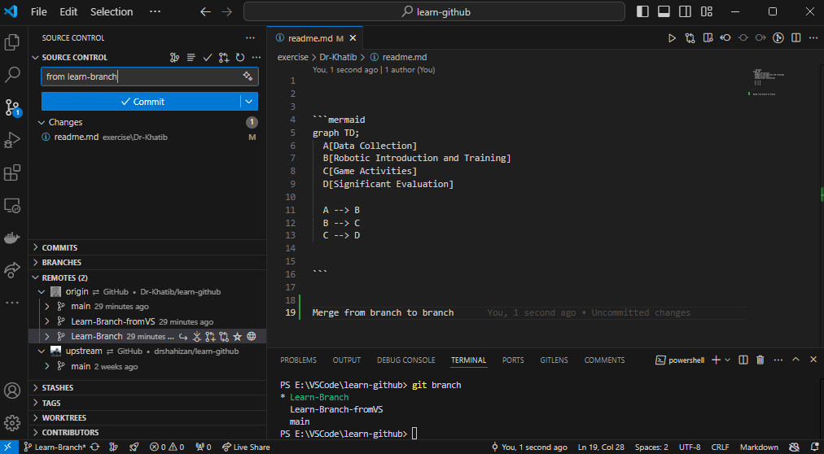
After make any changes Commit & sync branch with message
Make 1 changes
From learn-branch

Slide 13
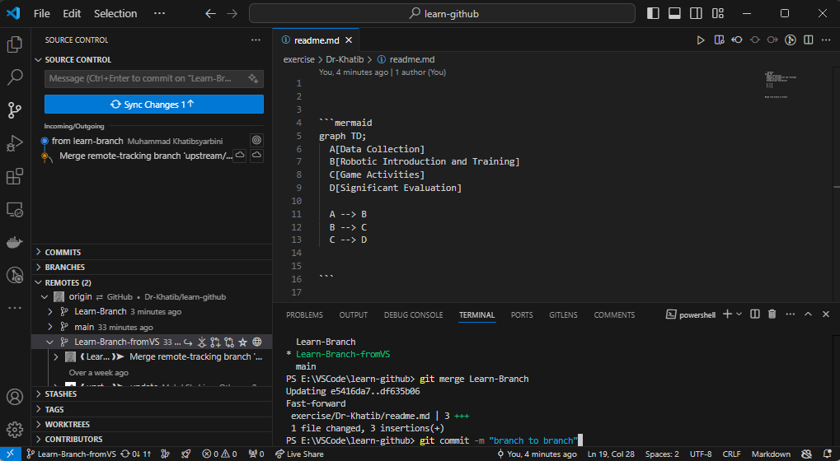
3. Sync changes
1. Switch to learn-branch-fromVS
2. git merge Learn-Branch
3. git commit –m “any message” or press sync button
4. git push origin Learn-Branch-fromVS

Slide 14
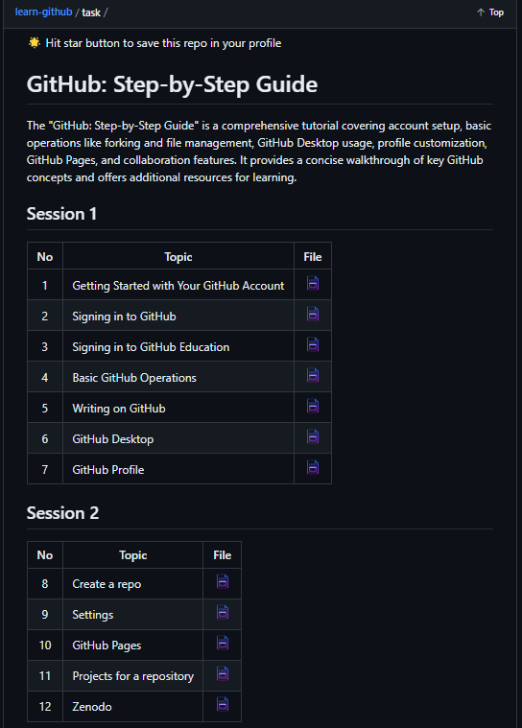
For More Extra References.. Visit Dr Shahizan GitHub
https://github.com/drshahizan/learn-github
https://github.com/drshahizan/learn-github/tree/main/task

Slide 15

THANK YOU
In the Name of God for Mankind
univteknologimalaysia
utm.my
utmofficial

